Slide 1

Lending Club Case Study
Welcome to the Lending Club case study presentation. Discover how risk analytics and data insights drive informed decision-making in the lending industry.

Slide 2

Business Understanding
Risks in Loan Decisions
Role of Risk Analytics
Identifying Risky Loan Applicants
Credit risk: Loss from borrower default.
Operational risk: Internal/external factors impacting loan operations.
Minimize losses by evaluating and managing potential risks in lending operations for informed decision-making.
Identify patterns indicating likelihood of loan default, helping make informed lending decisions and minimize financial losses.

Slide 3

Data Understanding
Dataset Overview
Loan and Applicant Attributes
Significance of Risk Identification
The dataset covers loans issued from 2007 to 2011, providing information on borrower attributes and loan characteristics for risk analysis.
Attributes include loan amount, term, interest rate, applicant's income, employment details, and credit history, vital for risk assessment.
Ensures smart loan decisions, reducing defaults and financial losses, pivotal in enhancing overall portfolio performance.

Slide 4
Data Cleaning
1
Handling Missing Values
2
Addressing Specific Columns
3
Rationale for Outliers Removal
Handled missing values by imputing medians for numeric columns and using appropriate strategies for categorical data, ensuring better data integrity.
For columns like 'revol_util,' filled missing values with the median to maintain data accuracy without altering distribution.
Outliers removed to enhance model robustness; focusing on 'annual_inc' ensures accurate risk assessment without distorted income data.

Slide 5
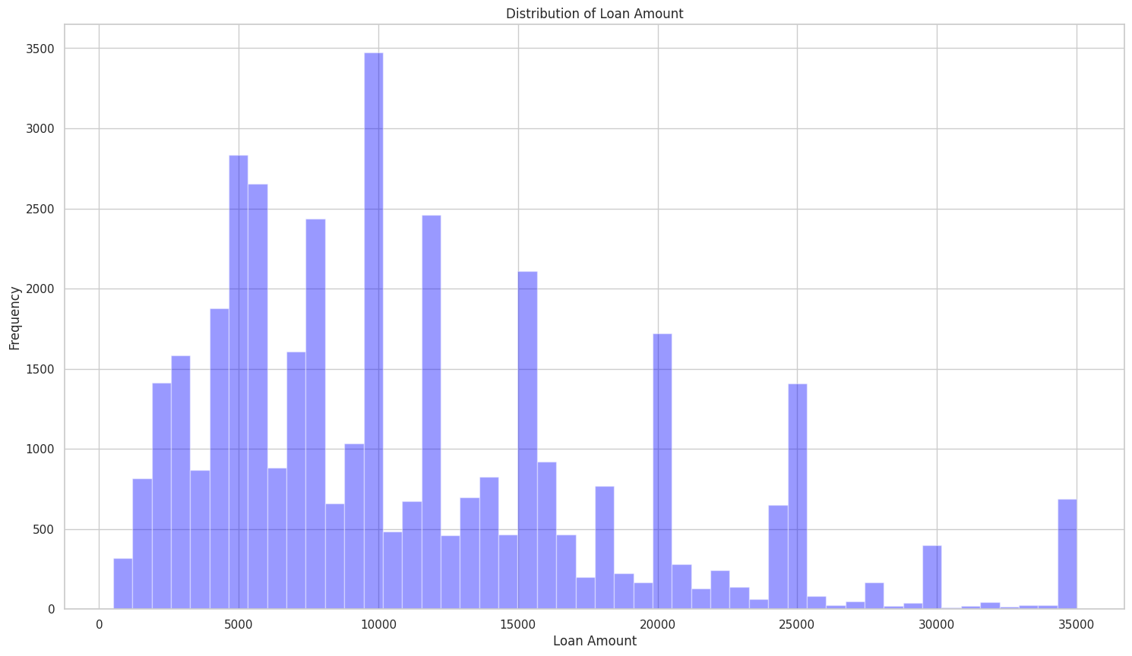
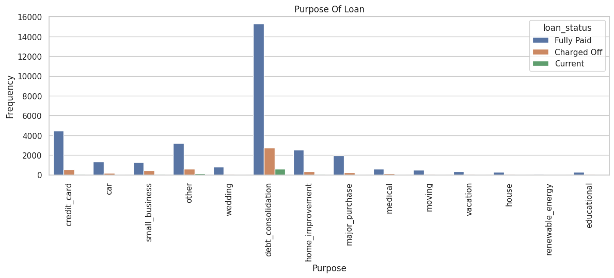
Univariate Analysis
Loan Amount Distribution
Identified Trends
The histogram reveals that a significant number of loans fall within a specific range, likely indicating common loan amounts requested by borrowers.
It helps identify patterns or trends in loan purposes that may be associated with higher or lower default rates.

Slide 6
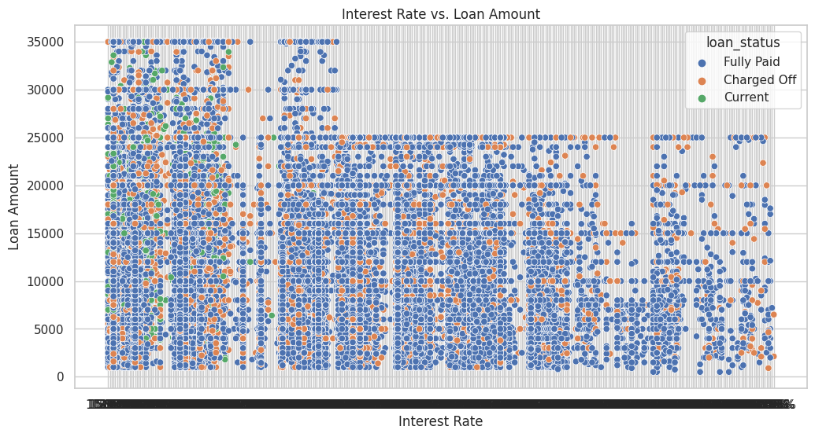
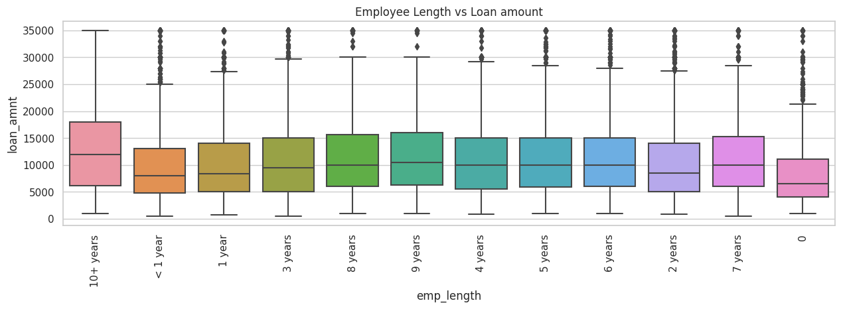
Bivariate Analysis
Loan Amount v/s Interest Rate
Employee length v/s Loan amount
Interest rates impact loan outcomes; higher rates correlate with smaller loans and increased charge-off risk. Tailoring rates based on risk can enhance portfolio performance and minimize losses.
The borrower who has 10+ years of experience are taking high amount of loan than others. less than 1 year expertise have taken less amount.

Slide 7

Time Analysis
1
Loan Status Proportions
Track the proportion of charged off and fully paid loans over time through a line plot, identifying changing trends.
2
Trends in Loan Status
Explore the observed trends and changes in loan status proportions, providing insights into loan performance.

Slide 8
Key Findings
The five key driver variables that indicate loan default, shedding light on crucial factors for risk assessment are –
Annual Income (annual_inc): Lower income levels correlate with a higher likelihood of default.
Debt-to-Income Ratio (dti): Higher dti ratios suggest increased risk of default.
FICO Score (fico_range_low and fico_range_high): Lower FICO scores are associated with a greater chance of default.
Loan Amount (loan_amnt): Larger loan amounts may pose a higher risk of default.
Revolving Line Utilization Rate (revol_util): Higher utilization of available credit predicts a higher risk of default.
Significance: Precise risk assessment, informed decision-making, and mitigation of loan defaults.

Slide 9


Conclusion
The case study on loan default risk analysis yielded valuable insights. We addressed missing data, outliers, and identified key driver variables. Our risk assessment model enhances decision-making in the lending industry, contributing to more informed practices. Rigorous data analysis is pivotal for effective risk management.

Slide 10

Future Recommendations
Deeper investigation into regional economic trends and borrower behavior could also enhance risk assessment accuracy.
Exploring advanced machine learning models, incorporating additional economic indicators, and refining feature engineering.

Slide 11

Thank You

